Slide 1
JAVA Lecture 23
Servlets

Slide 2
What is a Servlet?
A servlet is a Java class that handles HTTP requests and generates dynamic responses.
Managed by a web container like Apache Tomcat.
Part of Java EE (Jakarta EE) specification.
✅ Used for building web applications in Java.

Slide 3
Servlet Lifecycle Overview
The servlet lifecycle consists of three core phases:
Initialization (init())
Request Handling (service())
Destruction (destroy())
Managed entirely by the servlet container (e.g., Tomcat, Jetty).

Slide 4
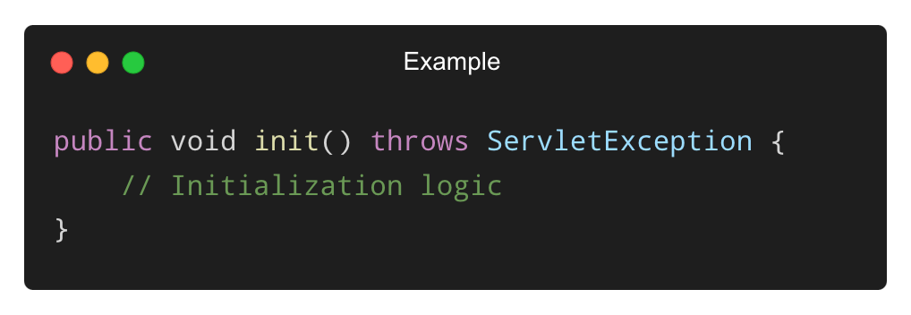
init() Method – Initialization Phase
Called once when the servlet is first loaded.
Used for resource setup, database connections, config loading, etc.
✅ Executes before handling any request.

Slide 5
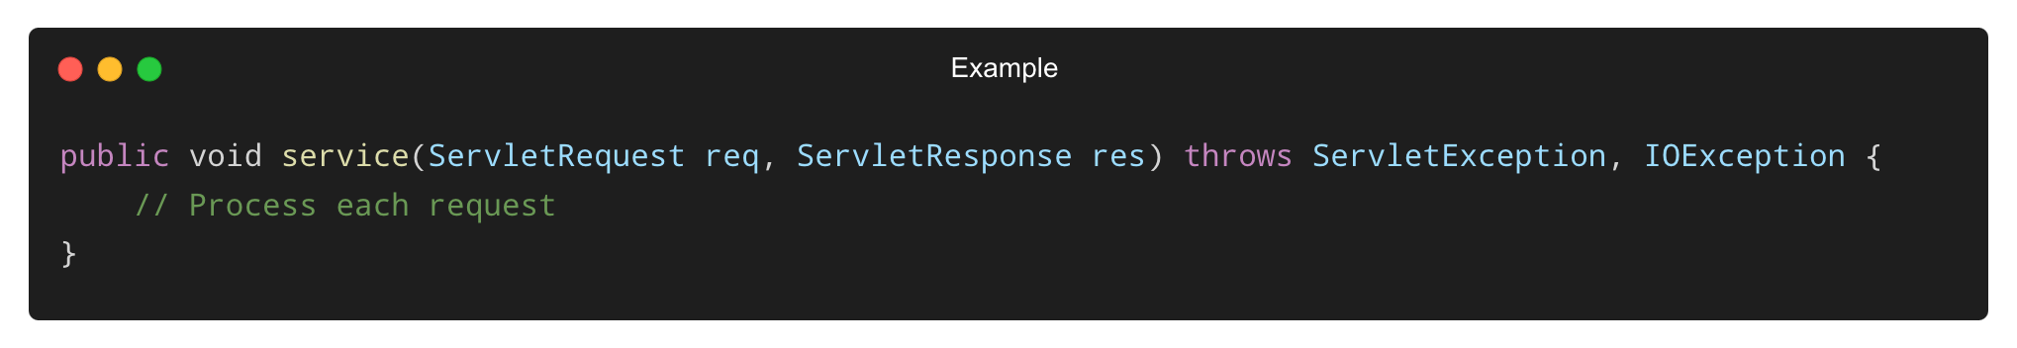
service() Method – Request Processing Phase
Called every time a request is sent to the servlet.
It calls doGet(), doPost(), etc. depending on HTTP method.
✅ Handles the core business logic.

Slide 6
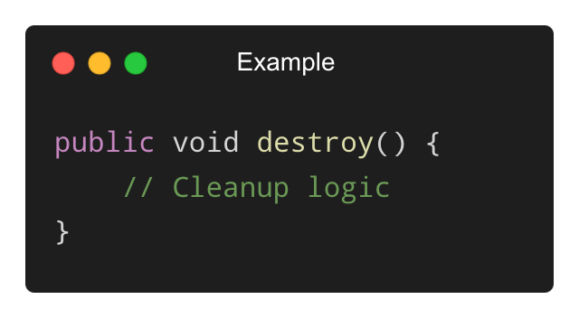
destroy() Method – Cleanup Phase
Called once before the servlet is unloaded.
Used for resource cleanup (e.g., closing DB connections).
✅ Occurs during server shutdown or servlet when not deployed.

Slide 7
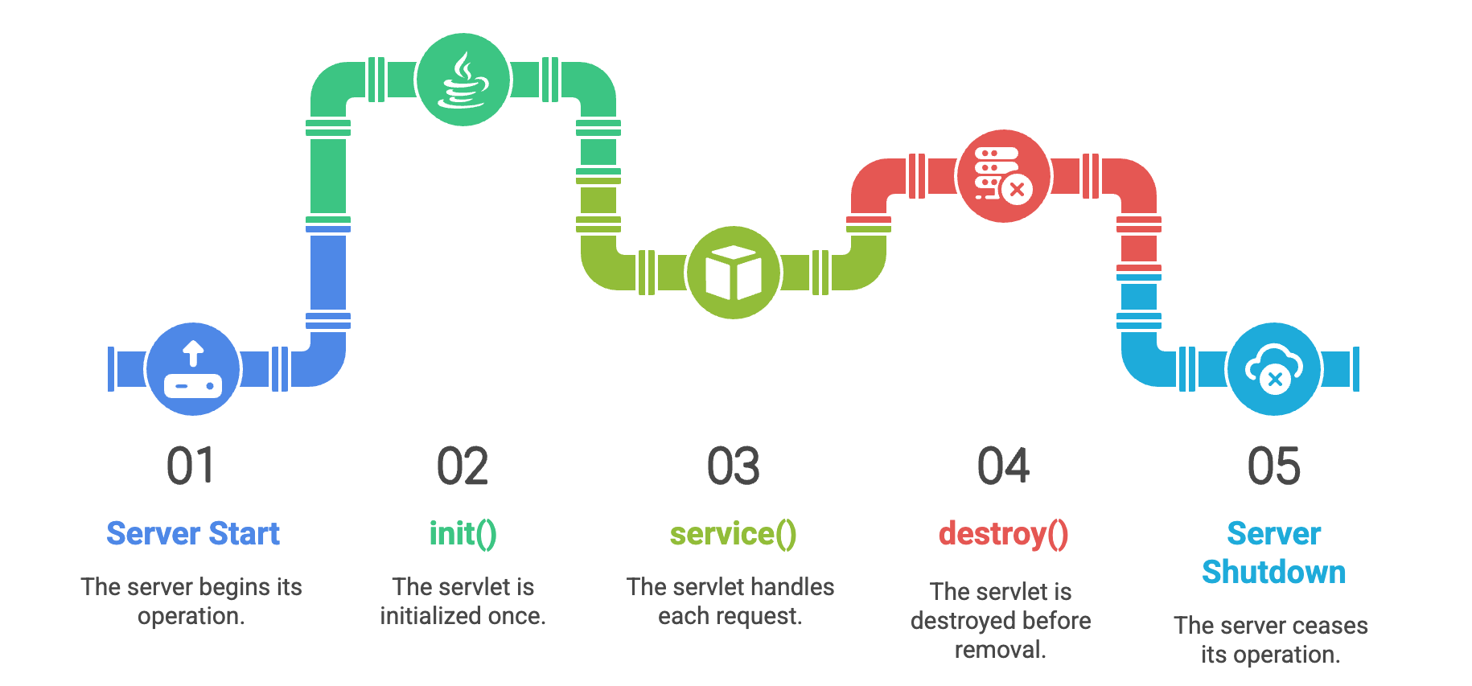
Lifecycle Diagram Summary
✅ All phases are automatically managed by the container.

Slide 8
What is the Servlet API?
The Servlet API is a set of classes and interfaces for handling web requests and responses.
Comes from packages:
✅ javax.servlet (core components)
✅ javax.servlet.http (HTTP-specific components)
✅ Defines a standard programming model for servlets.

Slide 9
Core Interfaces in javax.servlet
Interface | Purpose
Servlet | Base interface for all servlets
ServletRequest | Provides request information
ServletResponse | Sends response to client
ServletConfig | Configuration info for a servlet
ServletContext | Shared context between servlets
✅ Every servlet must implement the Servlet interface (usually via HttpServlet).

Slide 10
Key Classes in the API
Class | Description
GenericServlet | Simplifies servlet creation (protocol-independent)
HttpServlet | Abstract class for HTTP requests
ServletInputStream | For reading binary data from request
ServletOutputStream | For writing binary data to response
✅ Developers typically extend HttpServlet to create web applications.

Slide 11
ServletRequest and ServletResponse
ServletRequest:
Gets request data like parameters, headers, input stream
Common methods: getParameter(), getAttribute(), getInputStream()
ServletResponse:
Sends response data to client
Common methods: getWriter(), setContentType()
✅ Used in service() or doGet()/doPost() methods.

Slide 12
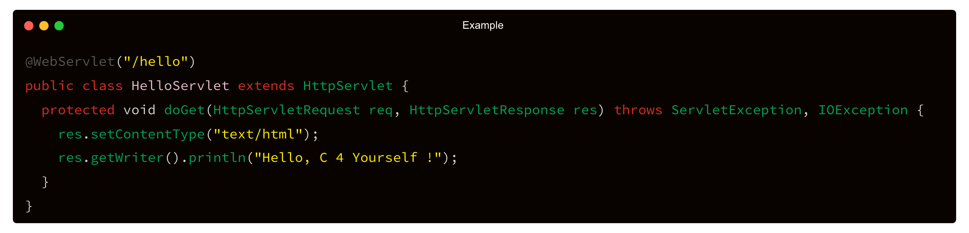
HttpServlet – The Most Used Servlet Class
✅ HttpServlet provides doGet(), doPost(), doPut(), doDelete(), etc.

Slide 13
ServletConfig and ServletContext
ServletConfig:
One per servlet
Contains init parameters from deployment descriptor
ServletContext:
Shared by all servlets
Used to share application-level data
✅ Useful for initialization and global configuration.

Slide 14
THANK YOU

